Slide 1
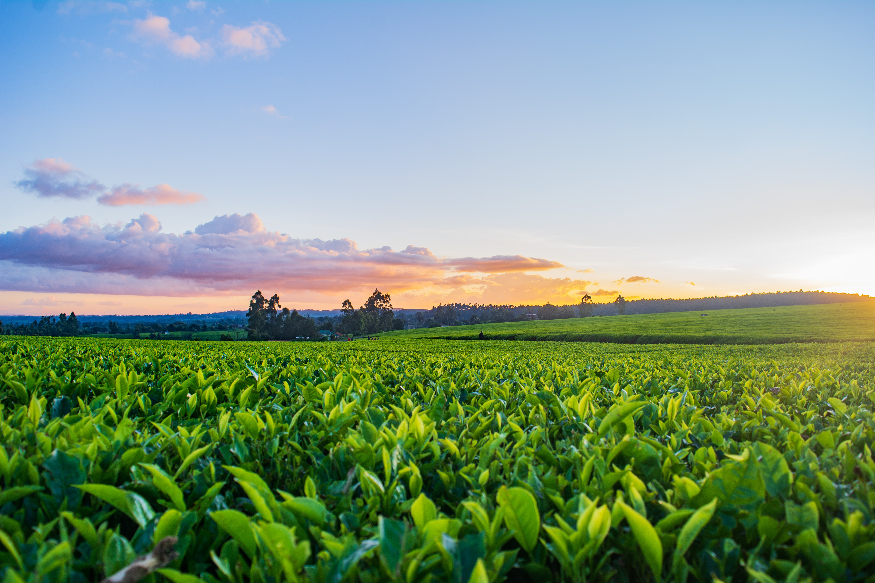
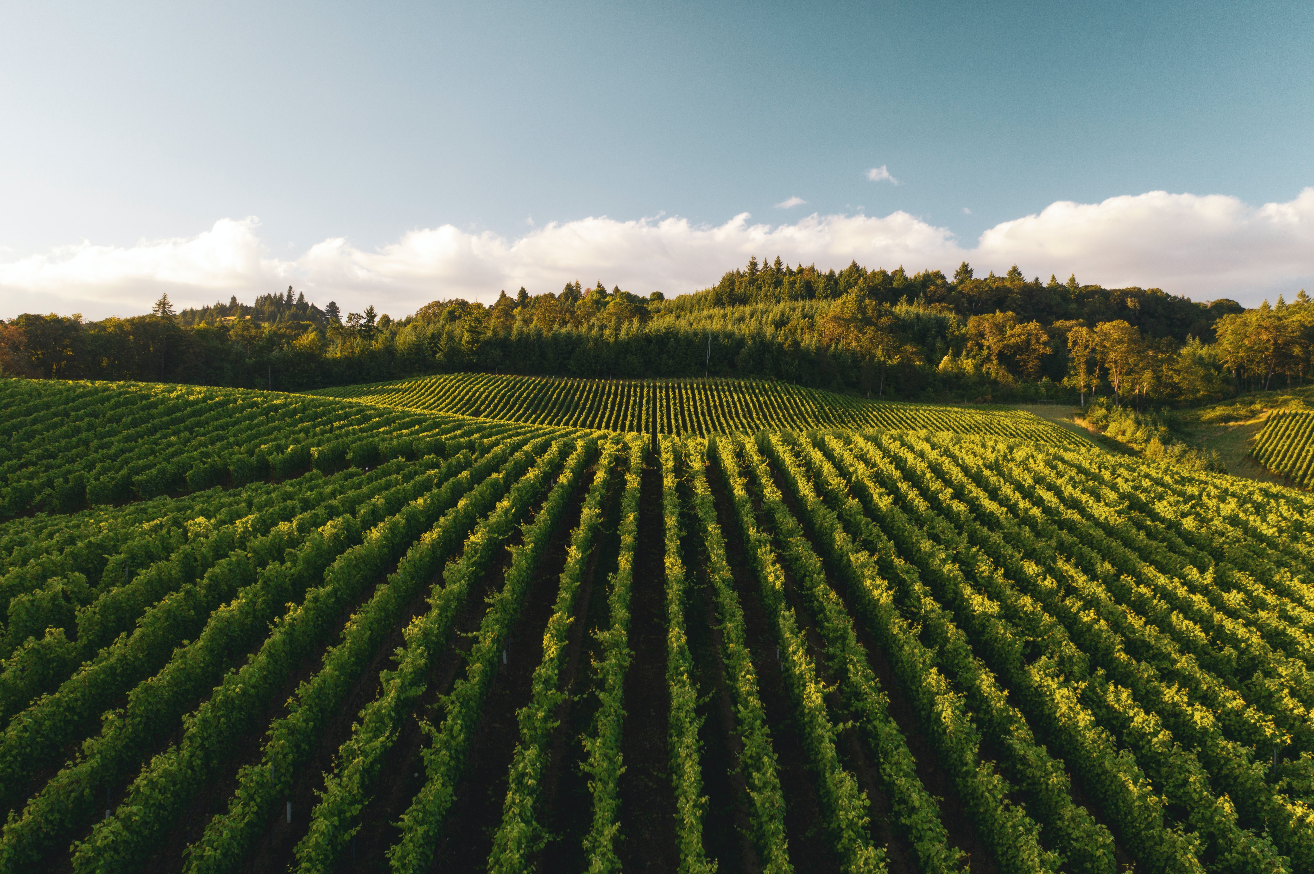
Agriculture Recommendation System Using Machine Learning
Aarya Totey 19102070
Avishkar Dalvi 20202002
Radha Rakshe 19102067
Riddhi Narkar 19102003
Under the Guidance of :
Prof. Deepak Khachane

Slide 2
Introduction
As per the census in 2011; in India, approximately 118 million people are farmers and 144 billion people are laborers working in an agricultural field.
With the production of agriculture activity of $375.61 billion, India is 2nd larger producer of agriculture products. India accounts for 7.39 percent of total global agricultural output.
With the vision of providing assistance and guidance to farmers during the crucial decision-making process required at various stages during farming, we propose a solution in the form of three ML models.

Slide 3
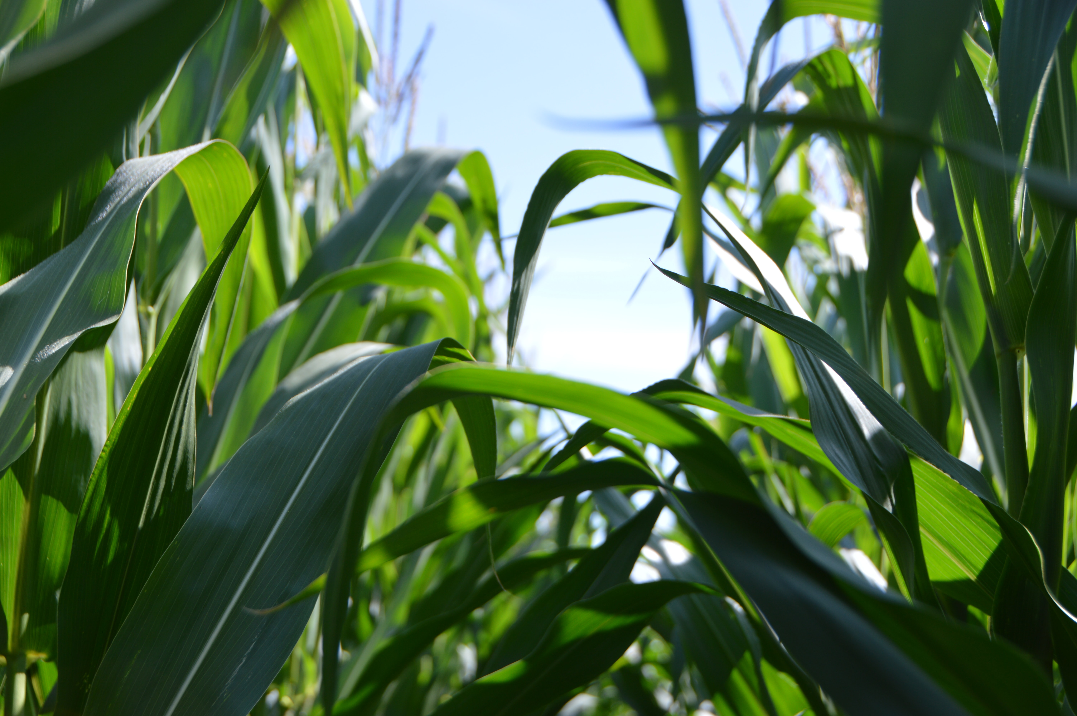
Problem Statement
To implement a software system for farmers or urban cultivators to assist with farming/cultivation decisions by providing solution for crop recommendation, fertilizer recommendation, and crop leaf disease identification.

Slide 4
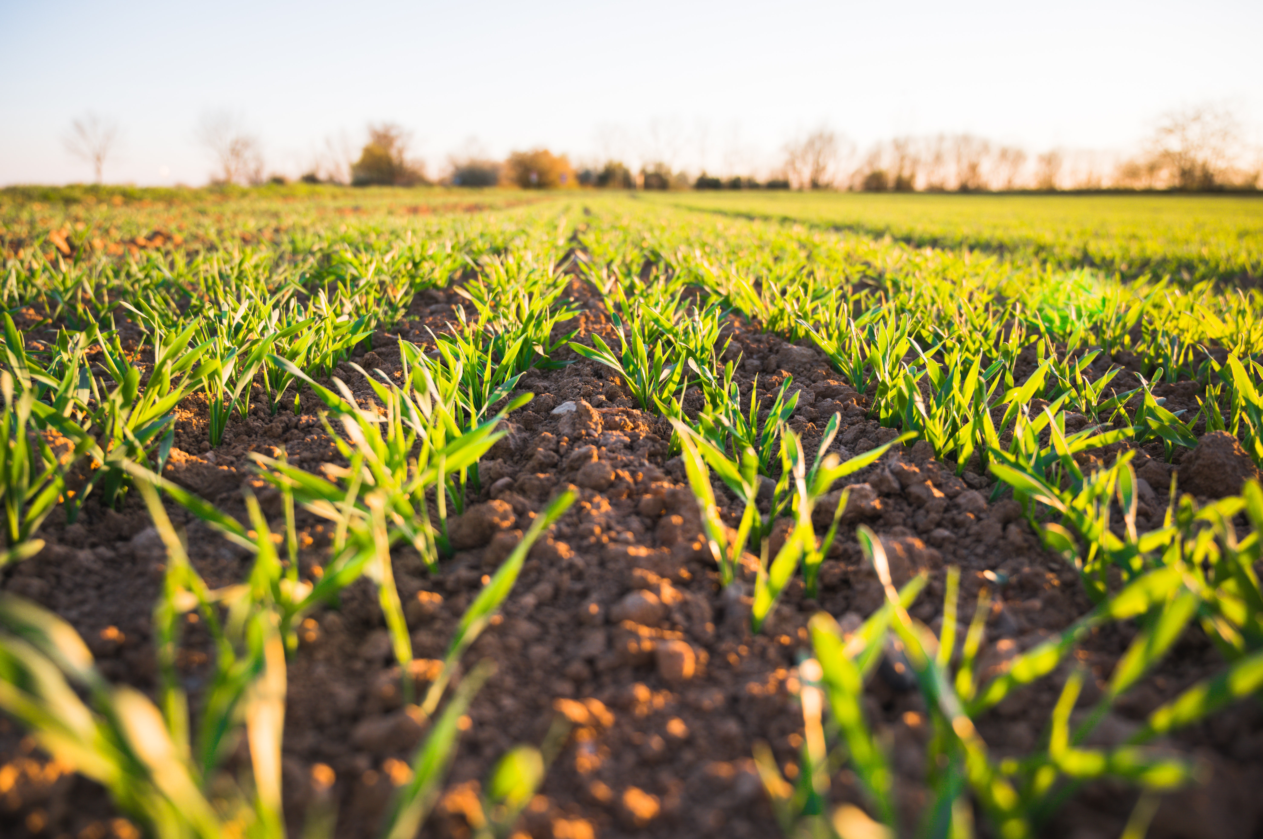
Objectives
﻿To provide a place to access help for crop related problems, the causes, and how to cure them, thus providing a solution-based approach.
To be able to make crop and fertilizer decisions using a soil test report.
To try to make the UI as simple as possible so that a naïve user, whose computer literacy is lower than average, too, can easily navigate.

Slide 5
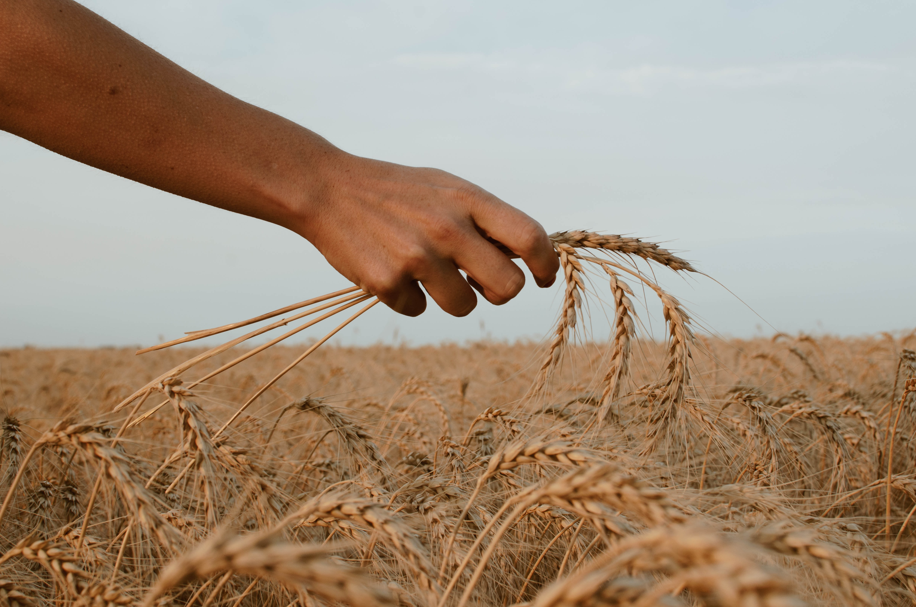
Scope
To assist any one who wants to grow crops, whether it be a farmer, or a plant enthusiast to make the agricultural decision making process easy by giving crop, and fertilizer recommendations, and identifying crop diseases and recommending cures to prevent them.

Slide 6
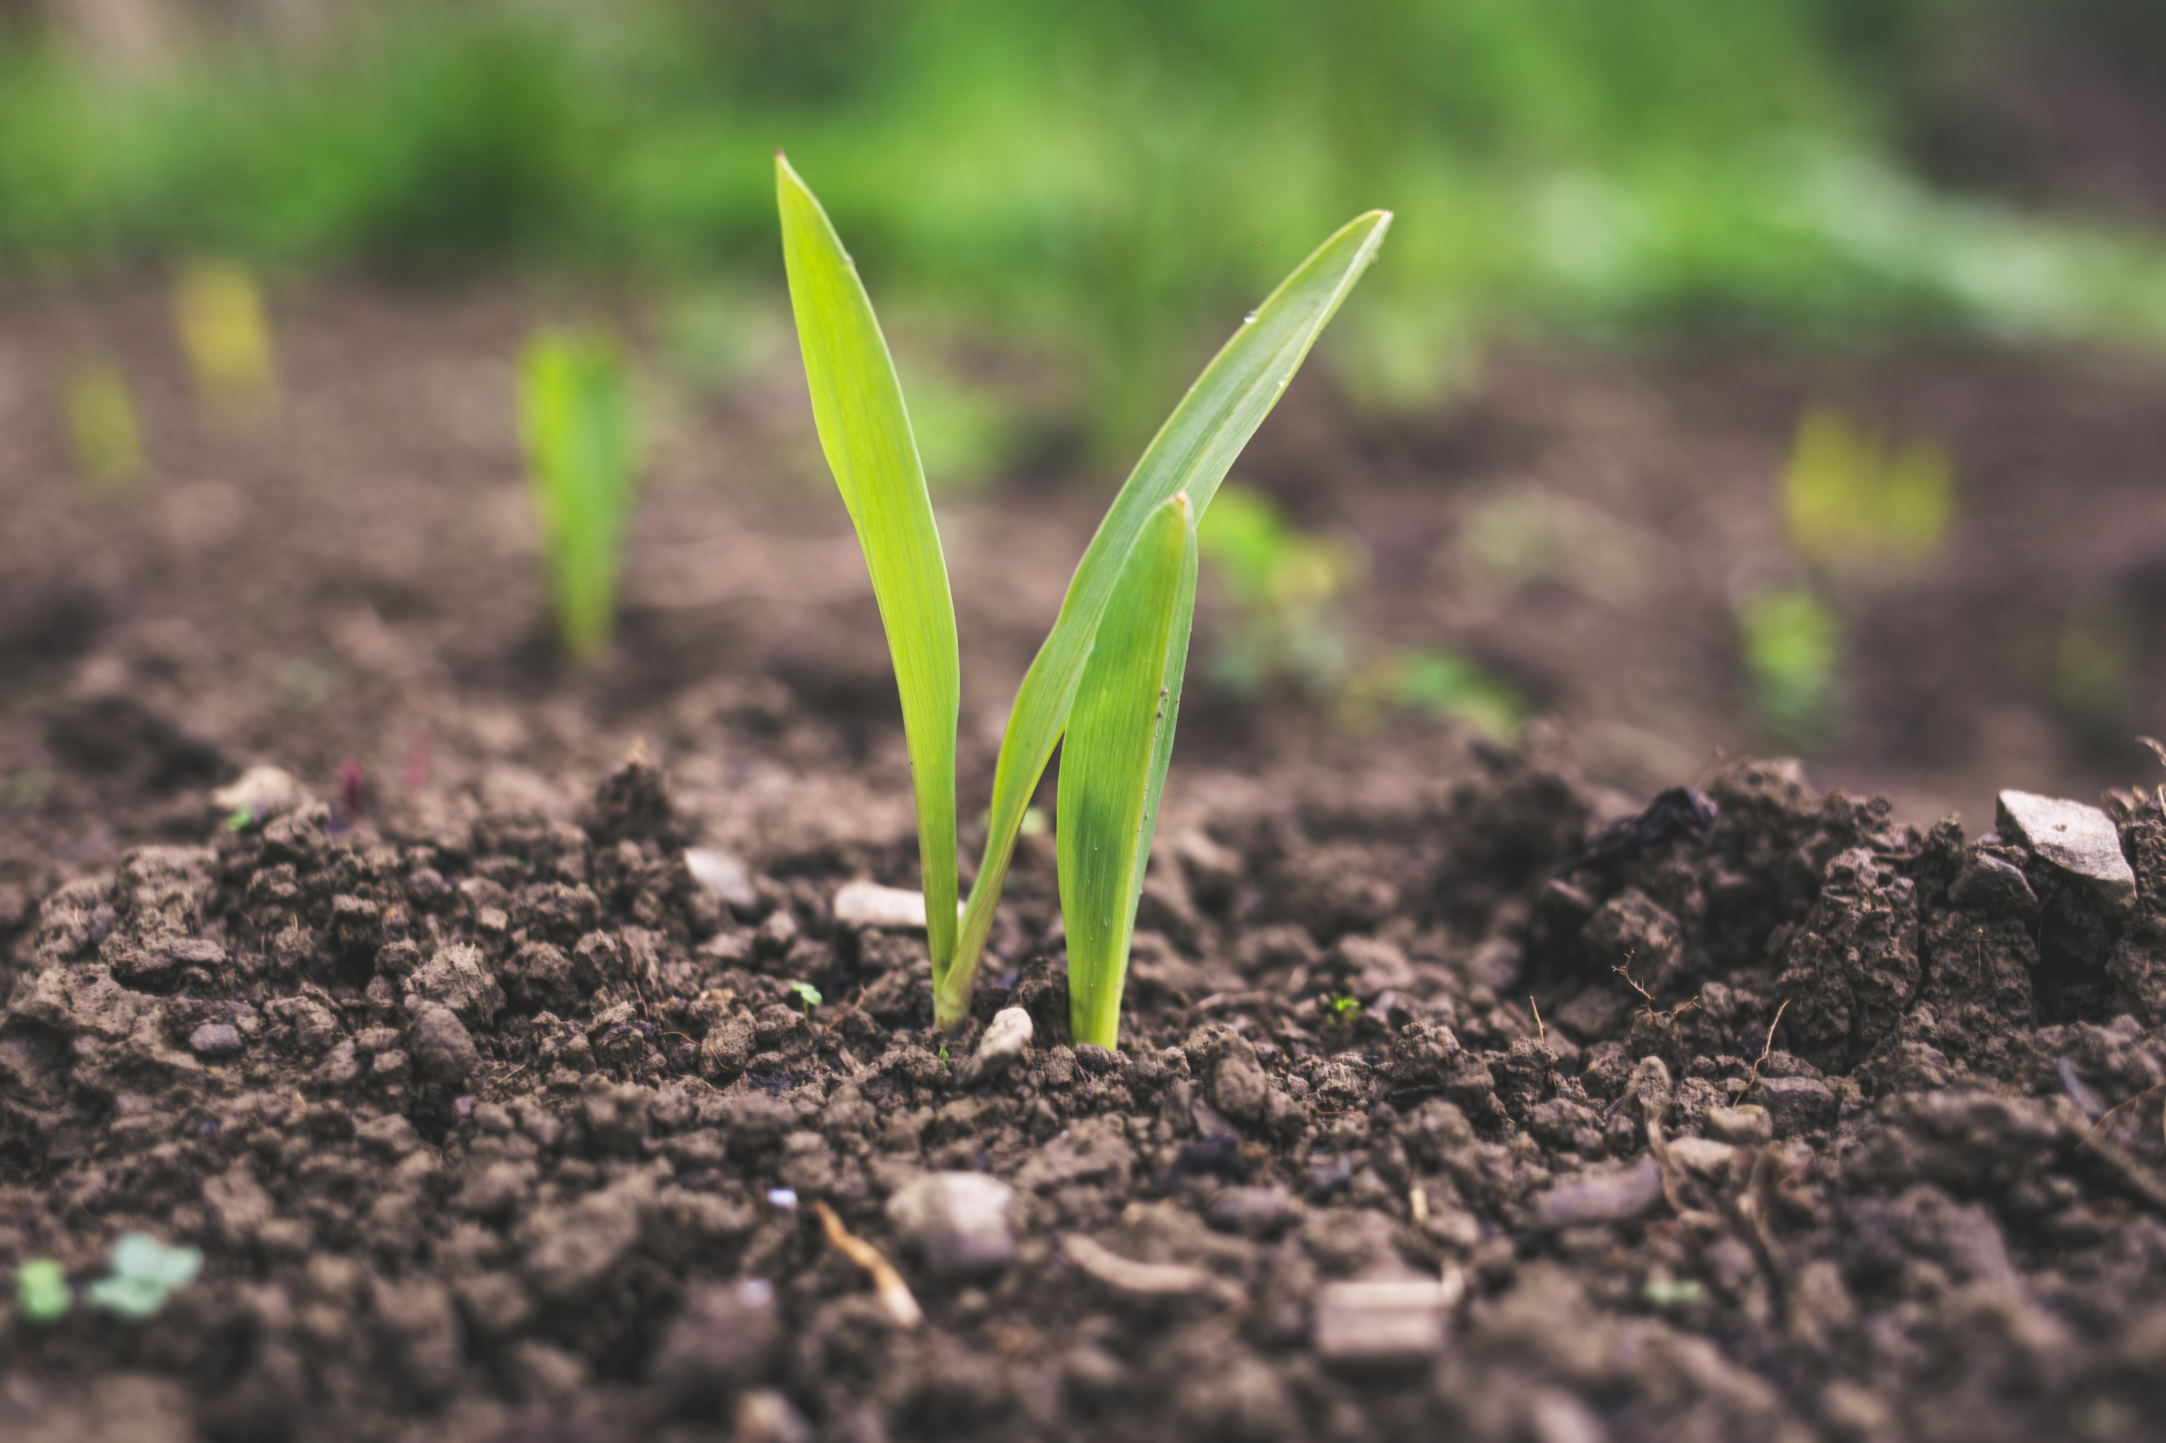
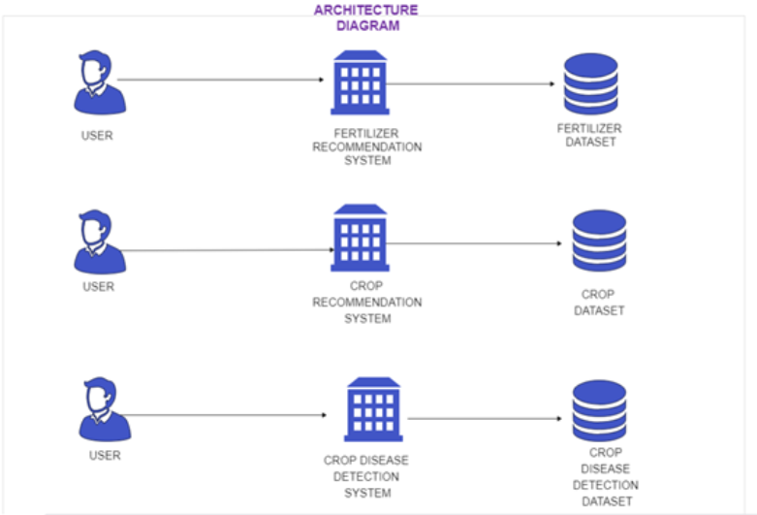
Architecture Diagram

Slide 7
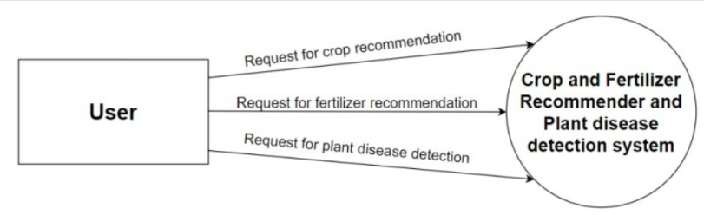
DFD: Level 0

Slide 8
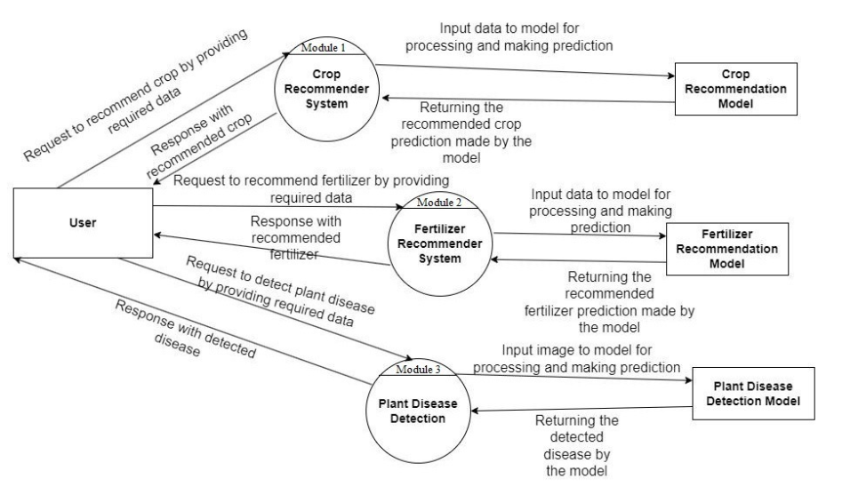
DFD: Level 1

Slide 9
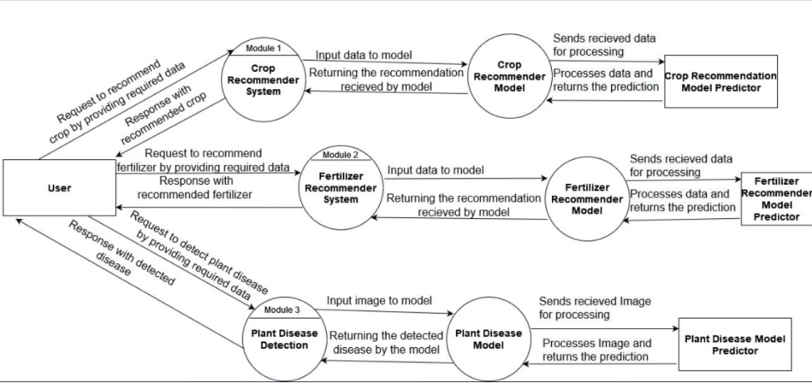
DFD: Level 2

Slide 10
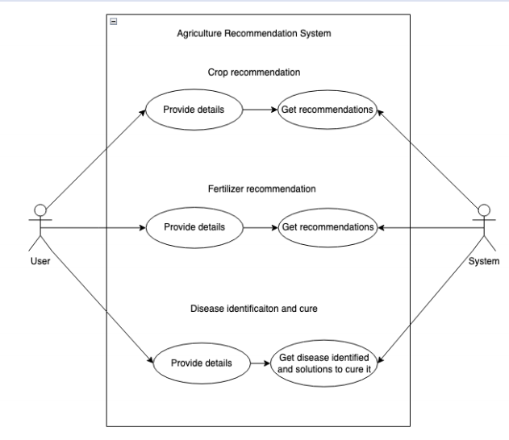
Use Case Diagram

Slide 11
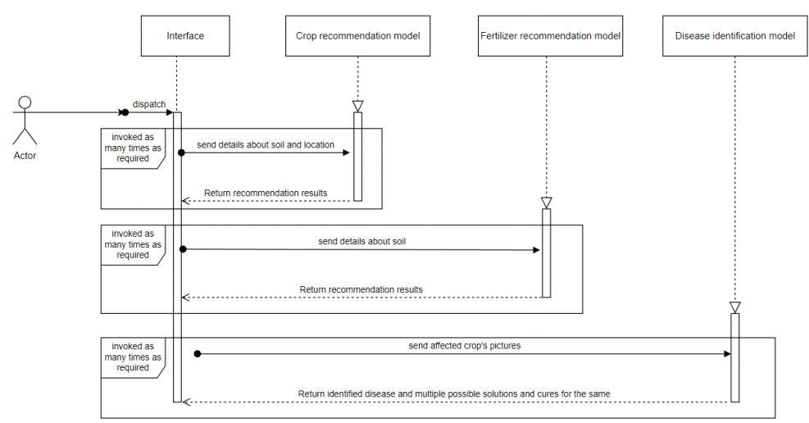
Sequence Diagram

Slide 12
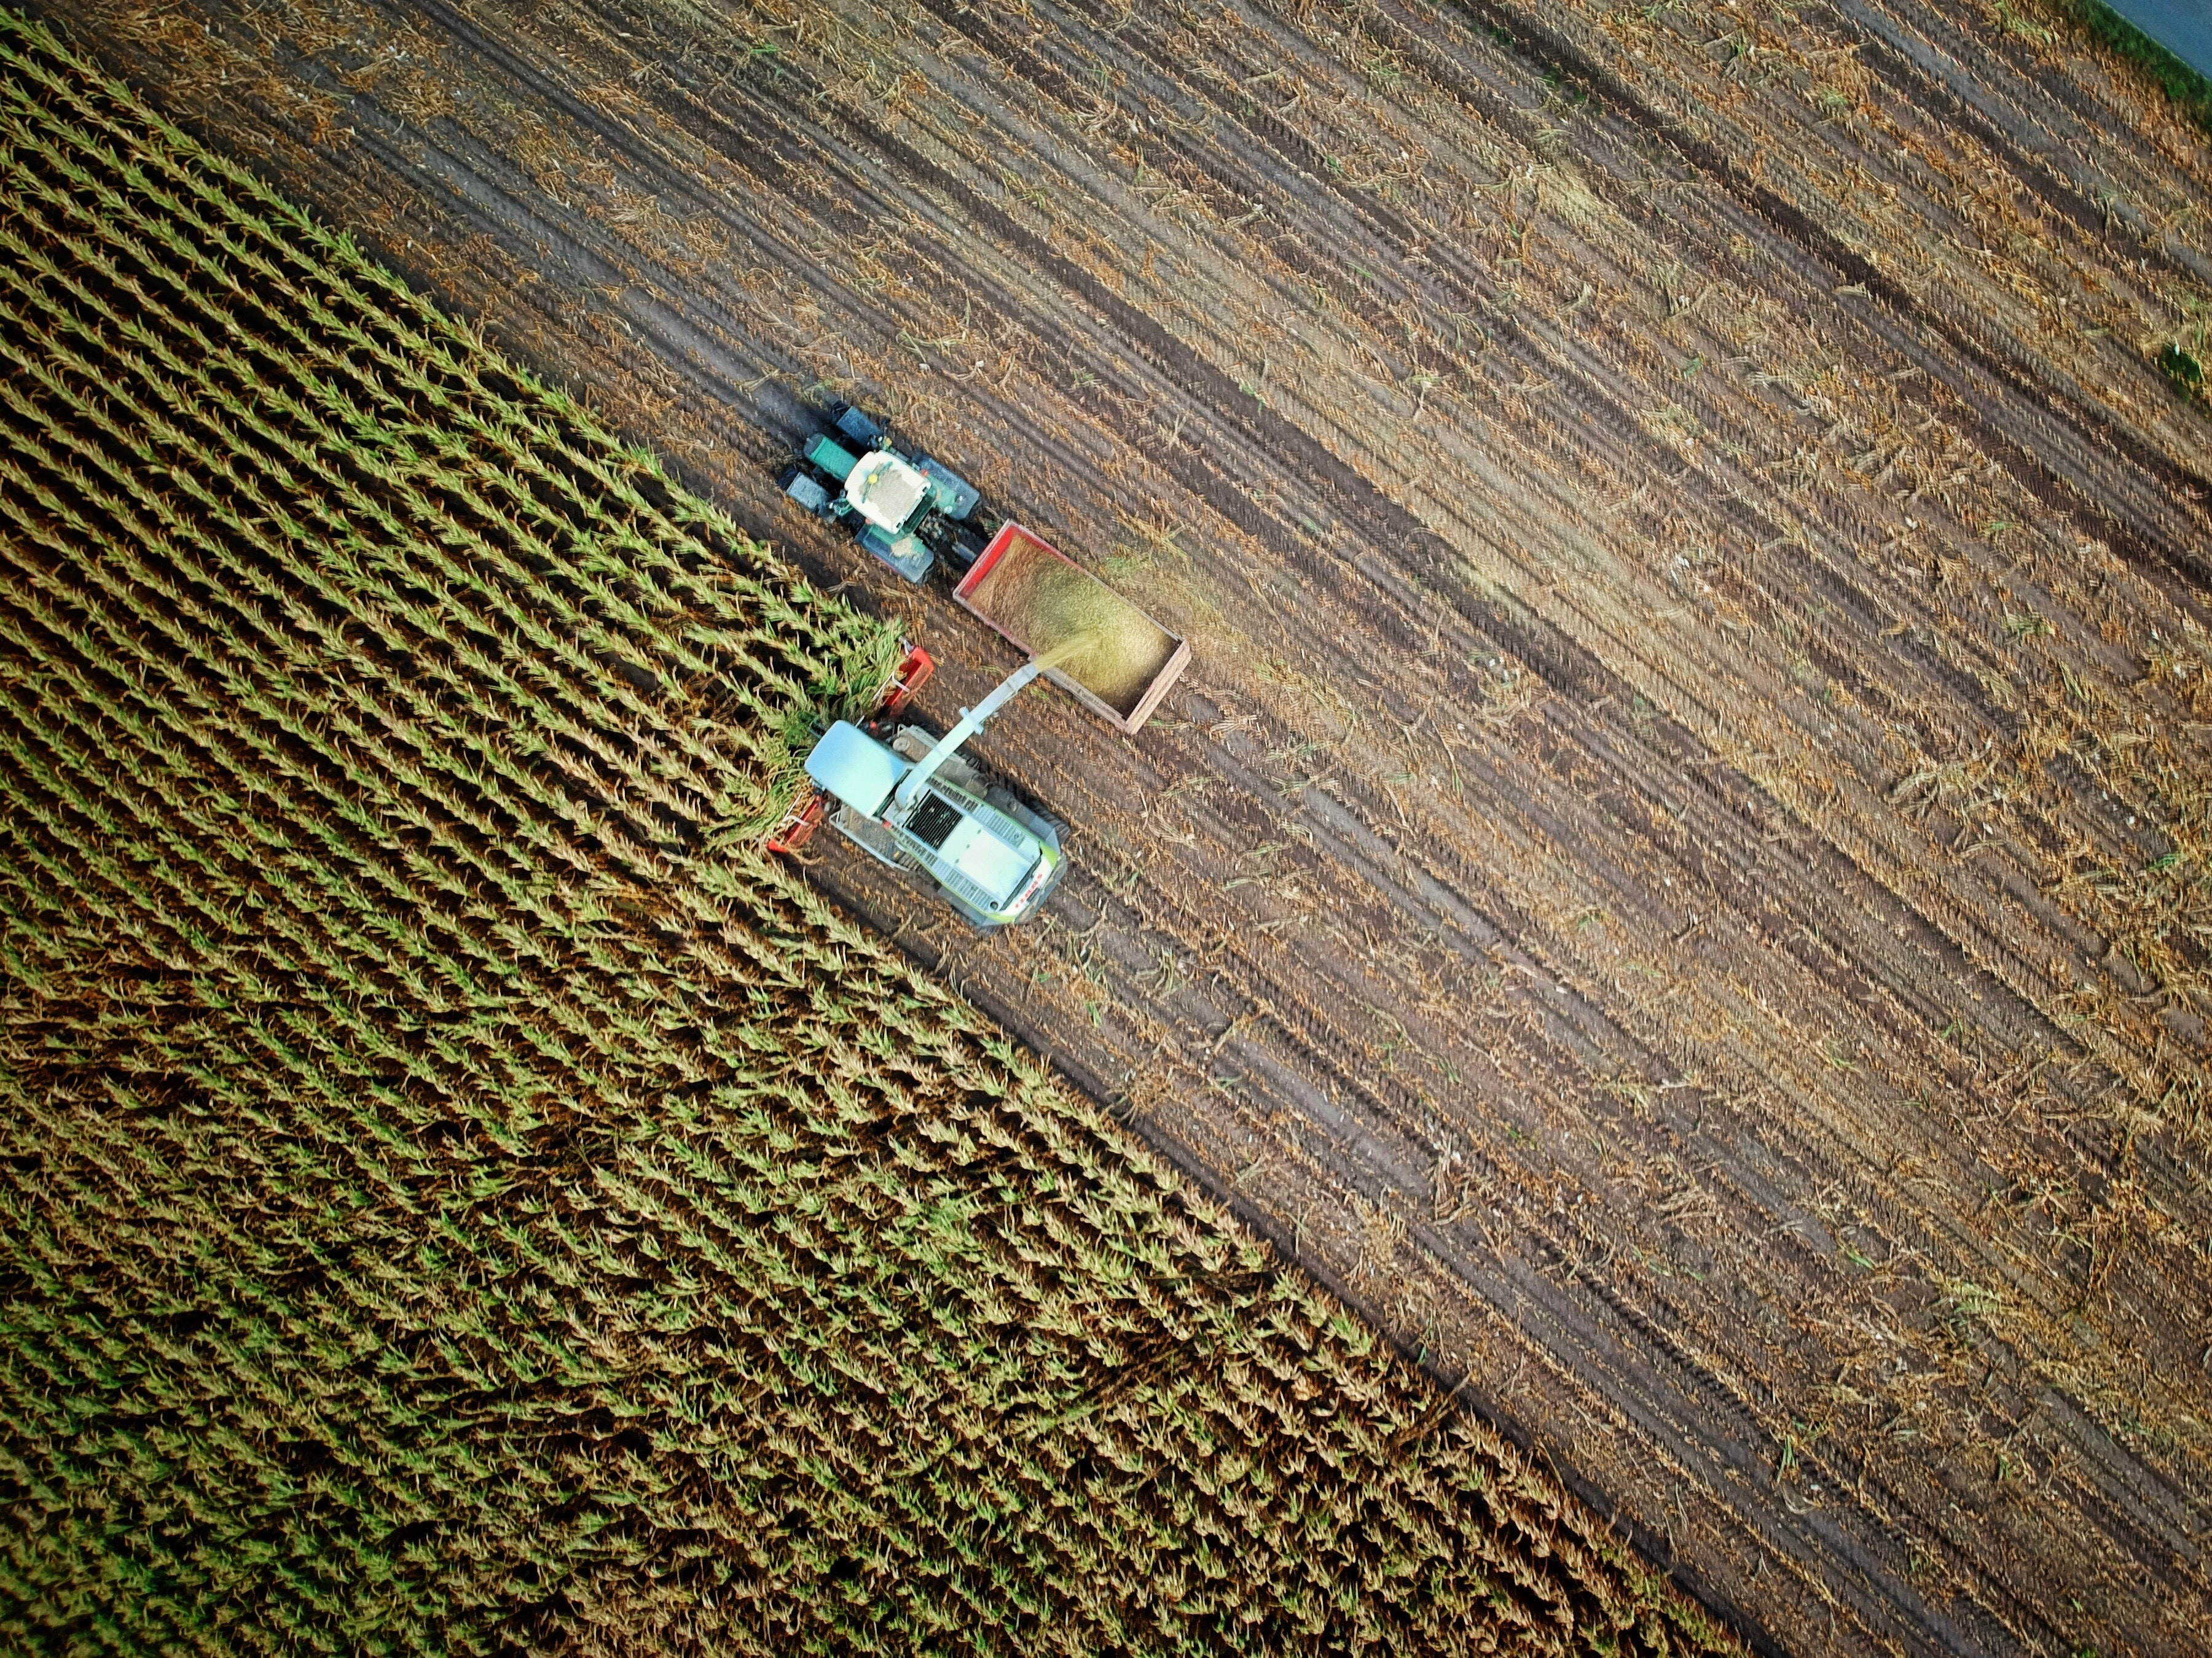
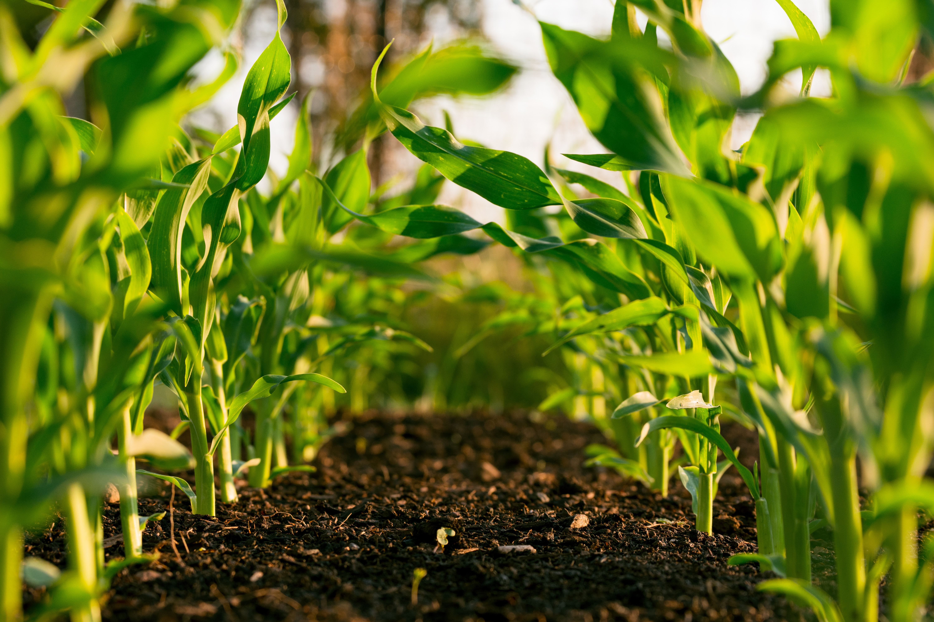
Result
Crop recommendation system: Predicts the favourable crops according to soil nutrient levels, pH, and current weather conditions within an acceptable accuracy range, given a soil test report is available.
Fertilizer recommendation system: Predicts the favourable fertilizers according to soil nutrient level within an acceptable accuracy range. Crop Disease Identification system: Classifies different crop diseases using a photo provided by the user, and provides solutions for the mitigating the disease.

Slide 13
Thank You!

